Slide 1
First Day in AWS
Tejprakash Sharma
Notes:
‹#›

Slide 2
Agenda
What is Cloud Computing
Popular Cloud Platform
Introduction to AWS Cloud
AWS Global Infrastructure
AWS Service Categories
Introduction to AWS EC2
Instance Type
Purchasing Option
EC2 Storage Type
AWS Security Groups
Launch your First Instance
EC2 SSH
Setup a WebServer
AWS Services Access Method

Slide 3
Cloud Computing
Cloud computing is the on-demand delivery of compute power, database storage, applications, and other IT resources through a cloud services platform via the internet with pay-as-you-go pricing.
Characteristics:
Cost
Security
Scalability and elasticity
Maintenance
Performance
Productivity

Slide 4
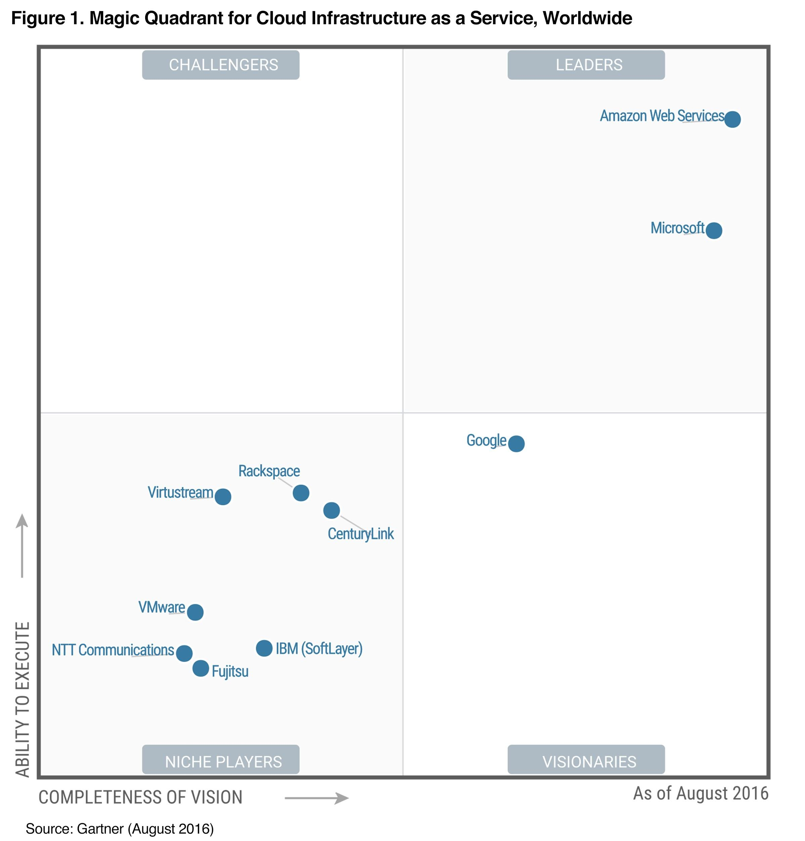
Popular Cloud Provider

Slide 5
Introduction to AWS
In 2006, Amazon Web Services (AWS) began offering IT infrastructure services to businesses in the form of web services -- now commonly known as cloud computing.
The AWS Cloud operates 42 Availability Zones within 16 geographic Regions around the world.
Regions:
US East (N. Virginia)
US East (Ohio)
US West (N. California)
US West (Oregon)
Canada (Central)
South America (São Paulo)
Asia Pacific (Singapore)
Asia Pacific (Sydney)
Asia Pacific (Seoul)
Asia Pacific (Tokyo)
Asia Pacific (Mumbai)
China (Beijing)
EU (Ireland)
EU (Frankfurt)
EU (London)

Slide 6
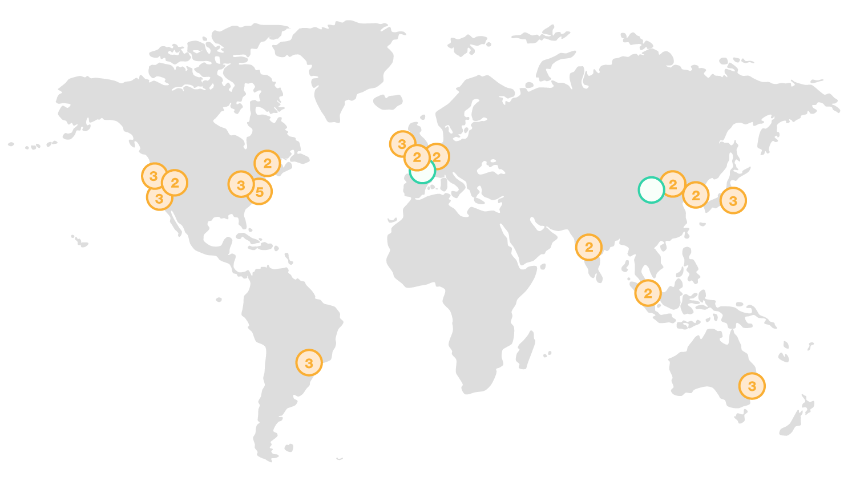
AWS Global Infrastructure

Slide 7
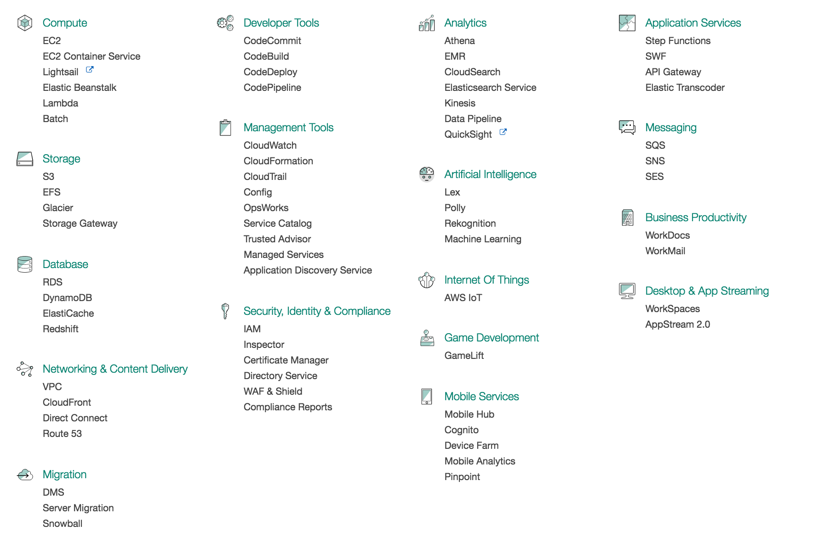
AWS Service Categories

Slide 8
Introduction to EC2
Amazon Elastic Compute Cloud (Amazon EC2) is a web service that provides secure, resizable compute capacity in the cloud.
Compute Optimized
General Purpose
Memory Optimized
Accelerated Computing Instances
Storage Optimized
https://aws.amazon.com/ec2/instance-types/

Slide 9
Purchasing Option
Amazon EC2 provides customers four different purchasing models that give you the flexibility to optimize your costs.
On-Demand
Reserved Instances
Spot Instances
Dedicated Hosts
https://aws.amazon.com/ec2/pricing/

Slide 10
EC2 Storage Type
Amazon EC2 provides you with flexible, cost effective, and easy-to-use data storage options for your instances. These storage options can be used independently or in combination to suit your requirements.
Amazon Elastic Block Store (Amazon EBS)
Amazon EC2 Instance Store
Amazon Simple Storage Service (Amazon S3)

Slide 11
AWS Security Group
A security group acts as a virtual firewall that controls the traffic for one or more instances. When you launch an instance, you associate one or more security groups with the instance. You add rules to each security group that allow traffic to or from its associated instances.

Slide 12
Accessing AWS Services
AWS Services can be accessed by three methods:
Console
CLI
SDK

Slide 13
Exercise
AWS Business Professional
AWS Technical Professional
https://www.apn-portal.com/
Notes:
‹#›

